Slide 1
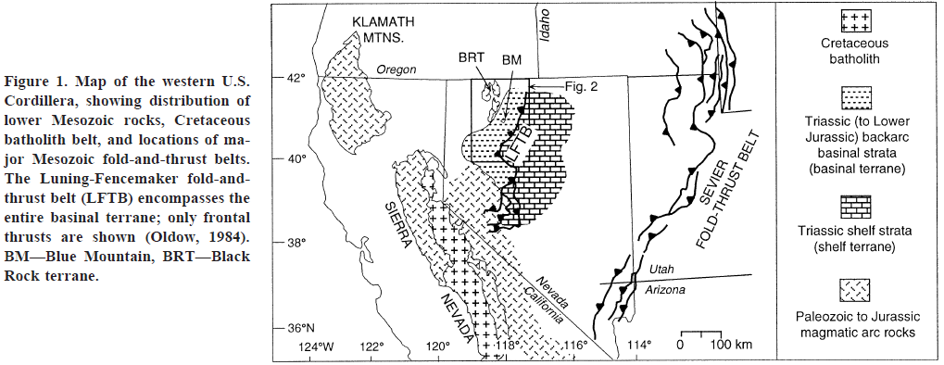
Structural evolution of a Mesozoic back-arc fold and thrust belt in the u.s. cordillera
Wyld, 2002
Geol 730 Presentation By: Neal Mankins

Slide 2
Purpose
Method
To examine the stratigraphic and structural setting of the Blue Mountains, NV in order to understand the controls behind the Luning-Fencemaker fold and thrust belt
Detailed mapping, stratigraphic & structural analysis of the Blue Mountains
Integrating relationships from other studies
(Focuses only on northern portion of the fold and thrust belt)

Slide 3
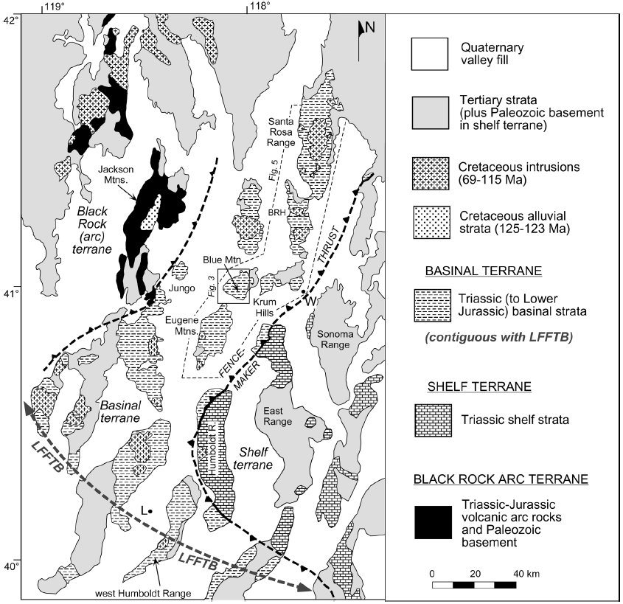
Background
Luning-Fencemaker fold & thrust belt
Structural province between arc terranes to the West and interior continent to the east
West Margin
Bounded by paleozoic & Mesozoic magmatic arc rocks of the Black Rock terrane
These arc rocks are thrust over coeval shelf strata
East Margin
Basinal-terrane strata are faulted over shelf rocks (middle-late Triassic) along the Fencemaker thrust

Slide 4
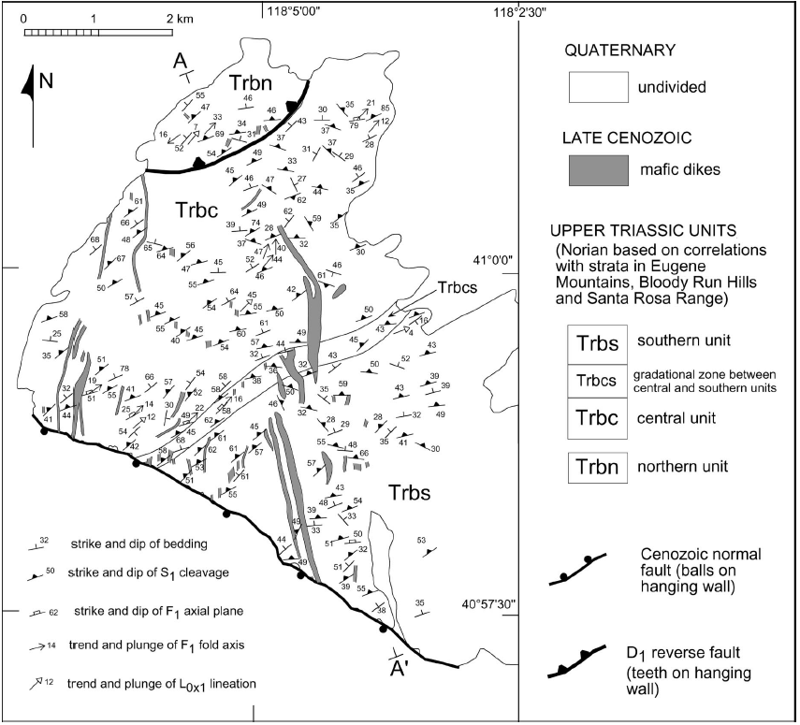
Blue Mountain
Geology
Trbn (Triassic Blue Mtn. North)
~500m of phyllite with thick 1-5m bedded quartzites
Trbc (Triassic Blue Mtn. Central)
~2800m of slate and phyllite
Trbs (Triassic Blue Mtn. South)
~3400m pf phyllite with interbedded siltstone, sandstone, and limestone
All of these units dip NW
Trbn is faulted over Trbc & Trbs
Trbc & Trbs are overturned (in the Blue Mtns.) based on age data & correlating similar stratigraphic sections in neighboring ranges (eg. Santa Rosa)
Overturned units are located on the western limb of an overturned syncline who's hinge region is to the SE of Blue Mountain

Slide 5
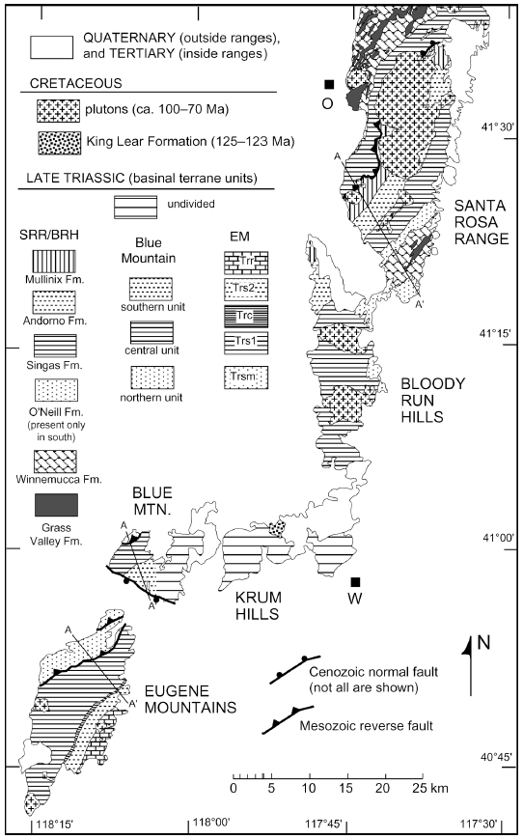
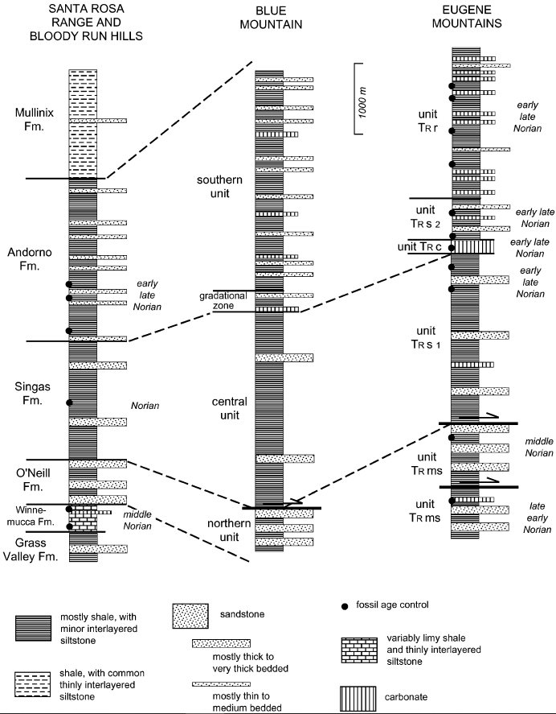
Correlation with other ranges
Southern Unit is similar to the Andorno Formation
Central Unit similar to the Singas Formation
Northern Unit is similar to the O’Neill Formation

Slide 6
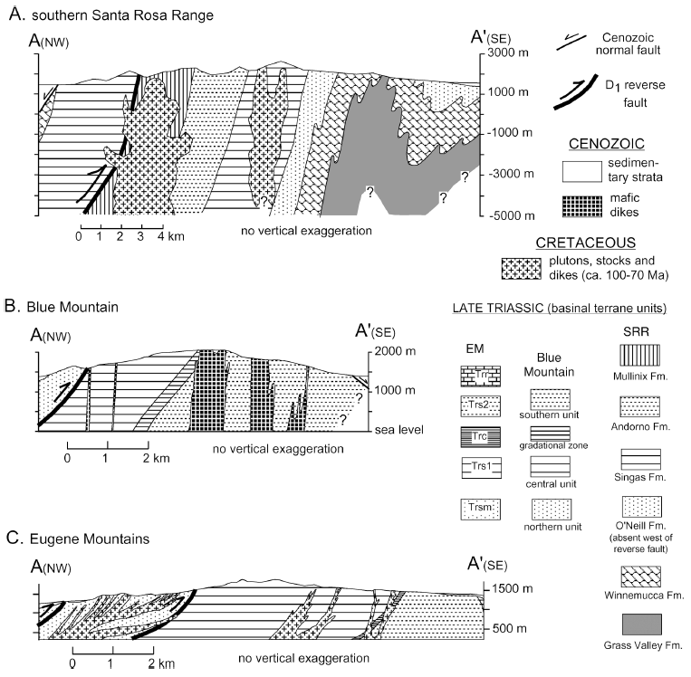

Slide 7
Deformation 1
D1 Deformation & M1 Metamorphism (Jurassic)
Low grade metamorphism <400ºC (subgreenschist conditions)
Pervasive structural grain within Triassic strata
Fold axes from this event have a trend & plunge ~NE
D1 structures are NE trending and NW dipping
NW-SE shortening with tectonic transport to the SE

Slide 8
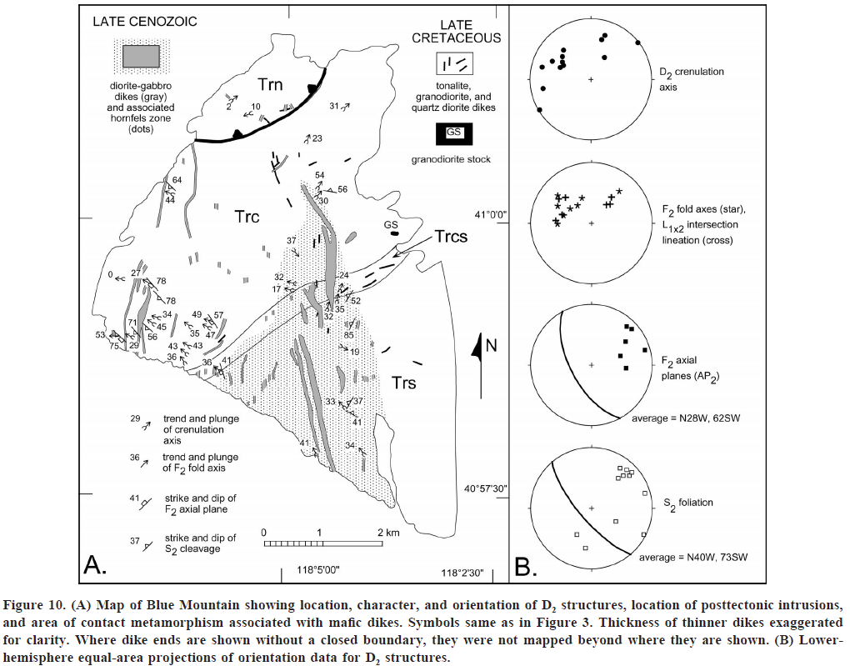
Deformation 11
D2 Phase (Middle-Late Cretaceous)
Open folds, crenulations, and spaced cleavage that cut older S1 fabrics
Fold axis tend to be larger/ wider and generally plunge NW
No metamorphic mineral growth is associated with the D2 event and is inferred to take place under more brittle conditions than D1

Slide 9
Interpretation
D1 Phase
Minimum shortening found to be 55-75% based on 20 measurements of D1 folds
Resulted in structural closing of the back-arc basin in the Jurassic
Mesozoic shortening of ~400km
“Timing of D1 deformation is no precisely defined” but deformed strata were intruded by a post tectonic pluton dated 165Ma placing the event ~late Early-Middle Jurassic
D2 Phase
Maximum NE-SW shortening found to be ~8-25% based on 10 measurements
D2 deformation is thought to be related to the Sevier orogeny (farther to the East)
Timing of this shortening event is defined only in the Santa Rosa range where late phase structures increase the strain and metamorphic grade in an intrusive stock dated 102Ma

Slide 10
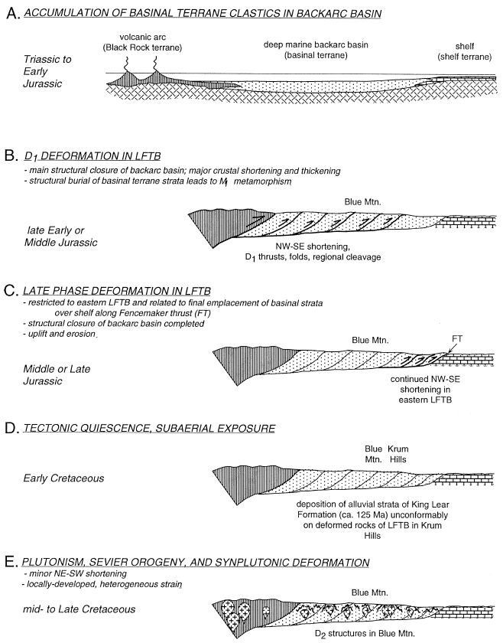
Time Space Model
Interpretation
Late Triassic deep-marine sedimentation (~6700m) in basin between continental shelf and offshore volcanic arc
Deformation began in early-middle Jurassic in the northern basinal terrane, defined by NW-SE shortening
Tectonic quiescence along with exhumation and erosion spanned Late Jurassic – Early Cretaceous
Deformation then continues again from Middle – Late Cretaceous accompanied by relatively minor shortening related to the Sevier orogeny (further to the East)
Intrusive granitic stocks emplaced syn D2 deformation

Slide 11
Take Home Points
Luning-Fencemaker fold and thrust belt is a structural province between arc terranes to the West and interior continent to the east
This ductile deformation event began in the early-mid Jurassic defined by folding and reverse thrusting accommodated by low grade metamorphism
Mesozoic shortening of ~400km (55-75% NW-SE )
Led to closure of Triasssic deep-marine back-arc basin

